Slide 1
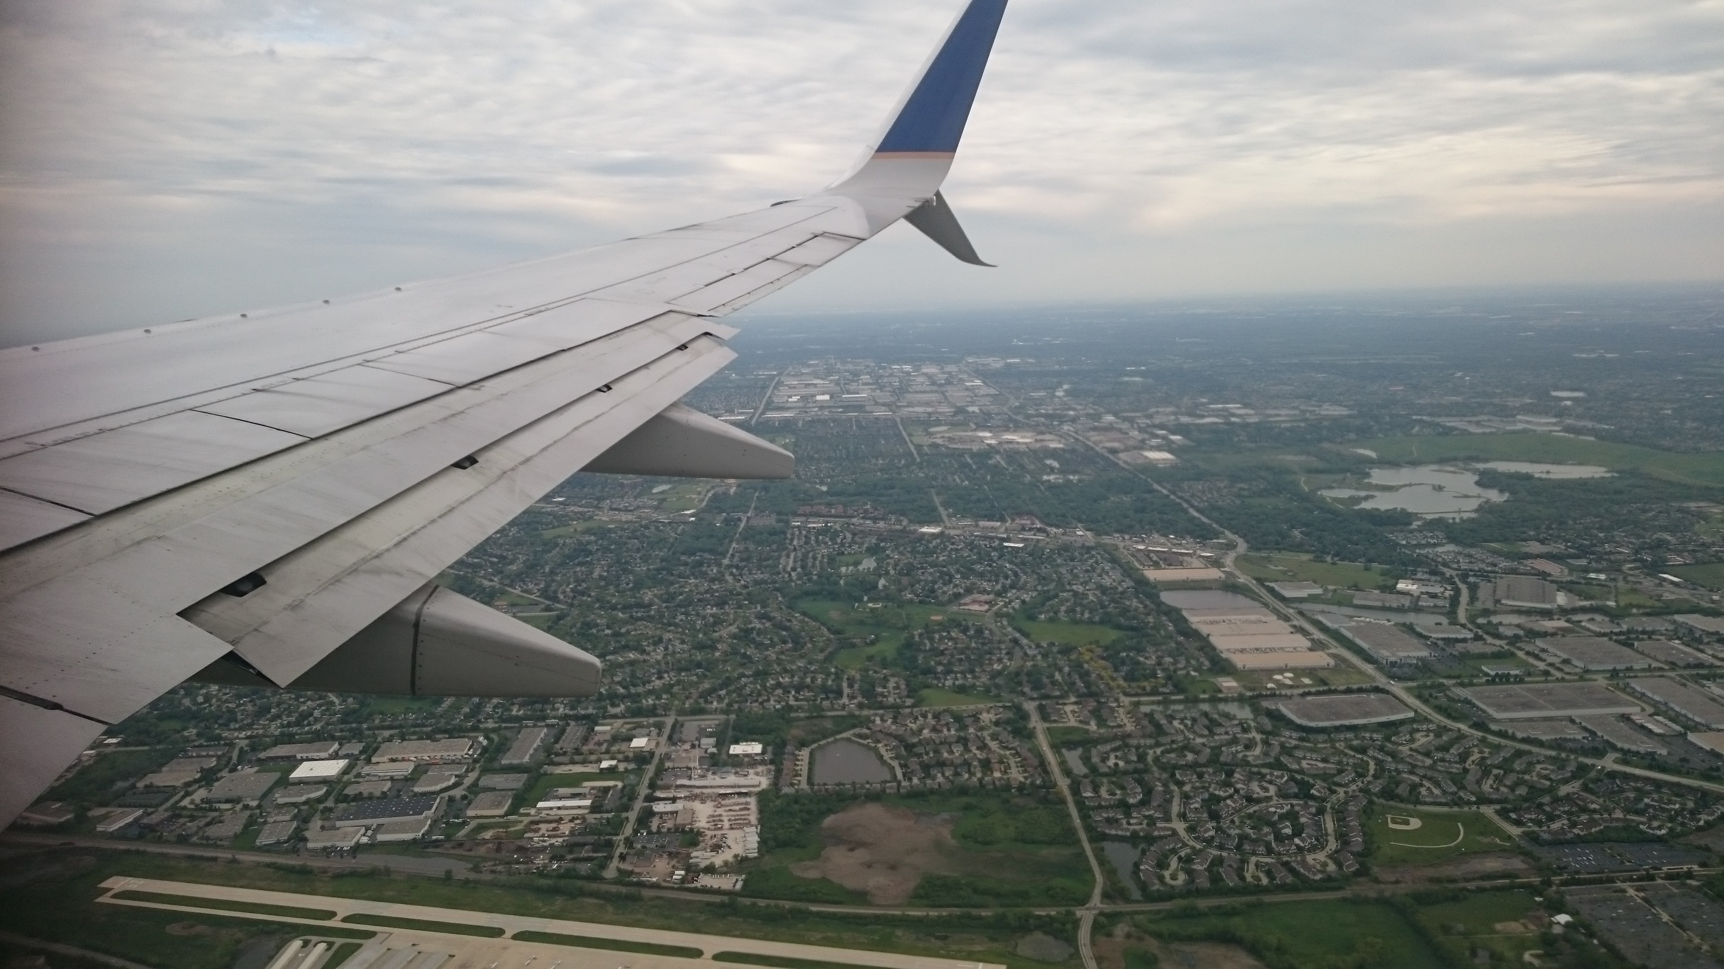
FIYOW
The Three Musketeers

Slide 2
THE PROBLEM
Alex’s needs
What we offer
(same class)
Bob’s needs
Chris’s needs

Slide 3
THE IDEA
Our package
(same class)
Language
Destination
Behaviours
Hobbies
Alex’s Data
Bob’s Data
Chris’s Data
Offer for Alex
Offer for Bob
Offer for Chris

Slide 4




THE SOLUTION
Data
(fiyow’s server)
A. Booking
(PC Web)
B. On flight
(Seat Screen)
C. Arrival
(Mobile web)

Slide 5
THE SOLUTION
FIYOW utilyzes users’ DATA
to optimize CUSTOMIZATION

Slide 6






THE DEMO
Meet Alex
Traveler
From Paris
To Singapore
Young
Tight budget
Language Barrier

Slide 7

A. BOOKING
(PC Web)
Alex’s Data
(FIYOW’s server)
Flight
Attractions
Hotels

Slide 8



B. ON FLIGHT
(Seat Screen)
Alex’s Data
(FIYOW’s server)
Language
Payment
Food
Entertainment

Slide 9

C. ARRIVAL
(Mobile Web)
Alex’s Data
(FIYOW’s server)
Taxi
Attractions
Hotels

Slide 10
THANK YOU!
FIYOW – Flight In Your Own Way

